Slide 1
Prototype for Chemical Price Checker Agent

Slide 2
Goal
Streamlit interface to perform the proposed workflow

Slide 3
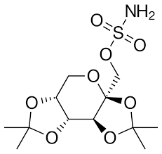
General Workflow
Input
Web scraper (Price)
Does this compound already available in the market? If so, how much?
Chemical Structures
Research Budget
Web scraper + Database of synthesis method / web scraper for synthesis method
Is there a well established way to synthesis the compound? If yes, get the materials and calculate the price.
Web scraper + synthesis method AI prediction (Retro Chimera / LLM based model)
If there isn’t a well established way, we can use AI to predict it. Get the materials. Calculate the price.
Output
Report on whether this compound fits the budget or not + the details on why
Useful for:
Experimental cost approximation
Grant planning
Manufacturing planning

Slide 4
Summary Website Chemical Seller
Nama | Region | Link
Sigma-Aldrich | International | Link to product list
ThermoFisher | International | Link to website
Enamine | International | Link to website
Selleck | Australia | Link to website
BLDPharm | China & Inter | Link to Website
AccelaChem | China | Link to Website
Wako Fujifilm | Japan | Link to Website
BioSynth | Europe (Swiss) | Link to Website
MedChemExpress | U.S.A. | Link to Website
Spex CertiPrep | U.S.A. | Link to Website
3ASenrise | China | Link to Website

Slide 5
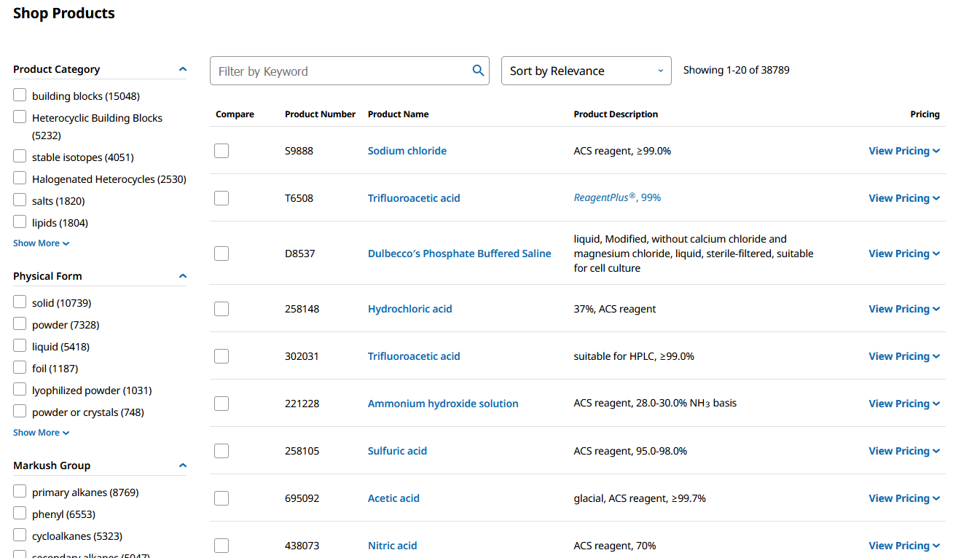
Sumber Data untuk Harga Bahan Kimia (International)
Sigma Aldrich
Link to product list
Daftar produk di bagian website agak bawah

Slide 6
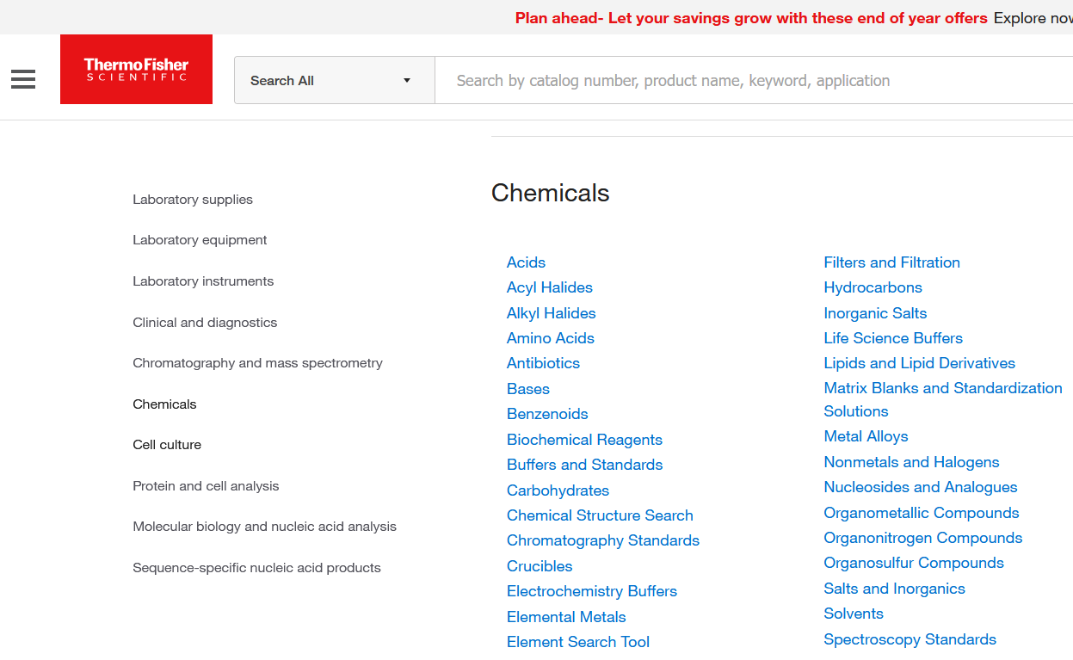
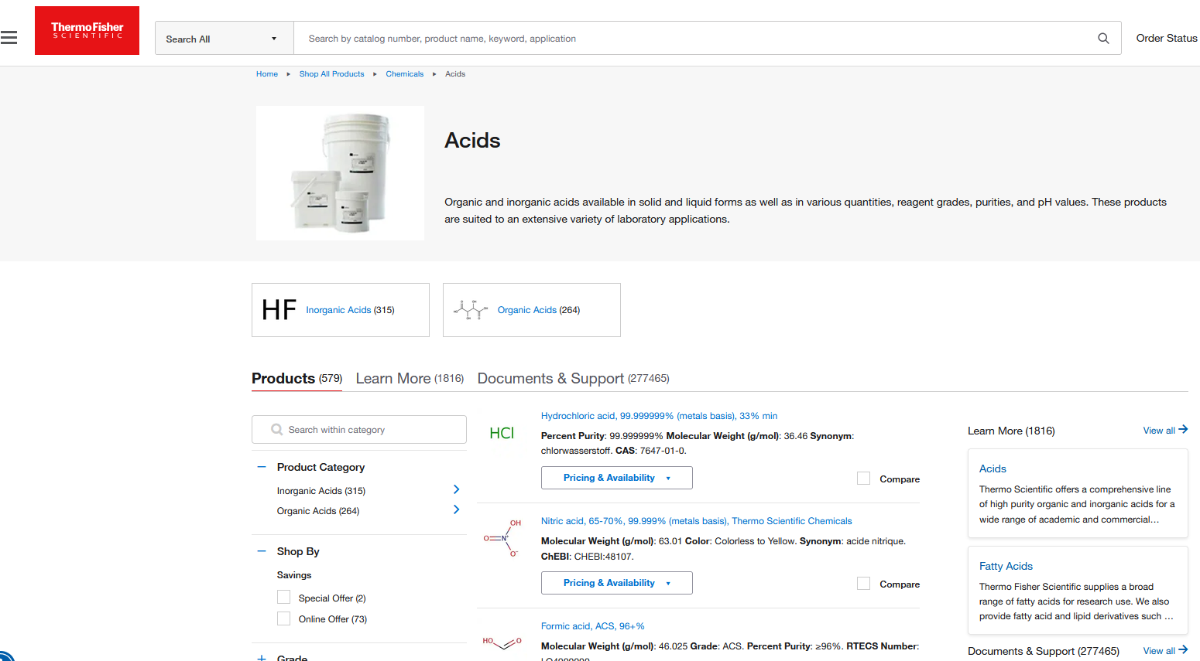
Sumber Data untuk Harga Bahan Kimia (International)
ThermoFisher - Link to website
Mungkin agak tricky, karena tiap section di chemicals ini tuh daftar produk semua

Slide 7
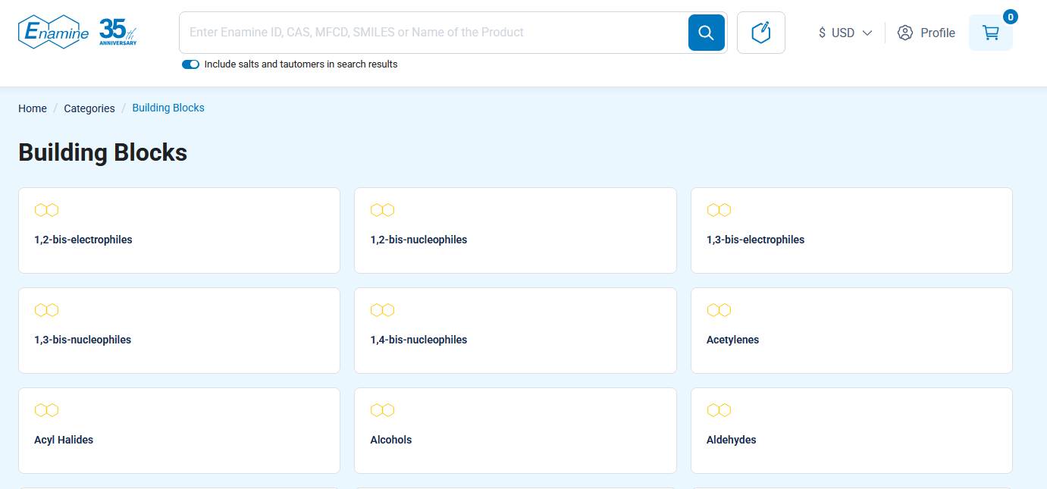
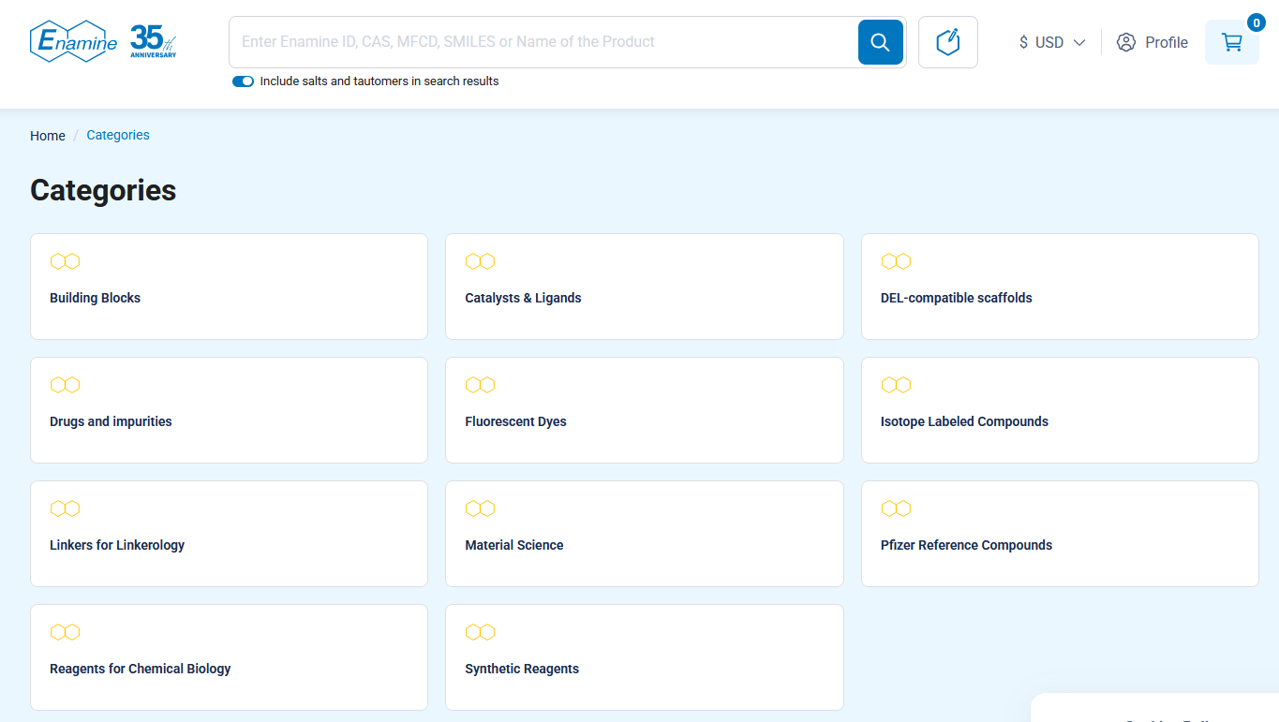
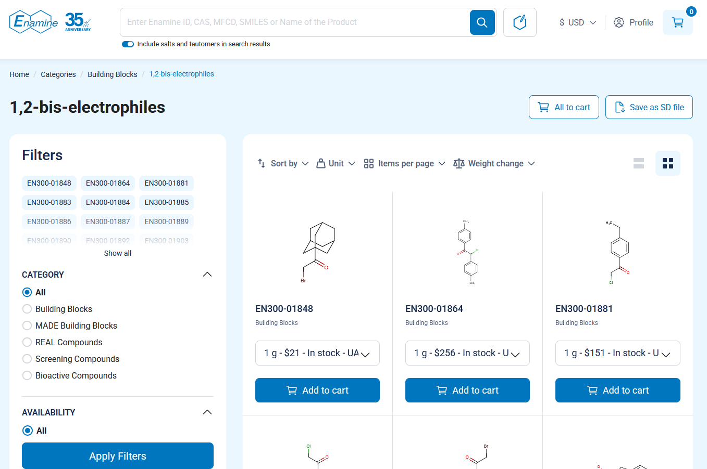
Sumber Data untuk Harga Bahan Kimia (International)
Enamine – Link to website
Web ini pagesnya bercabang

Slide 8
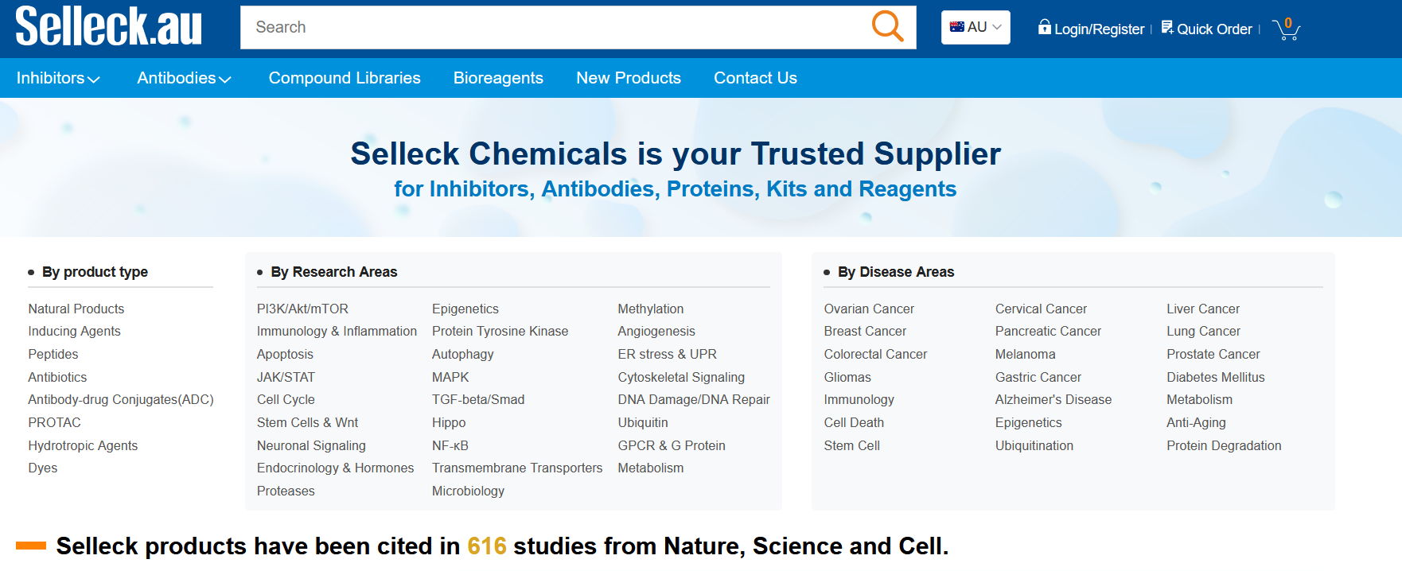
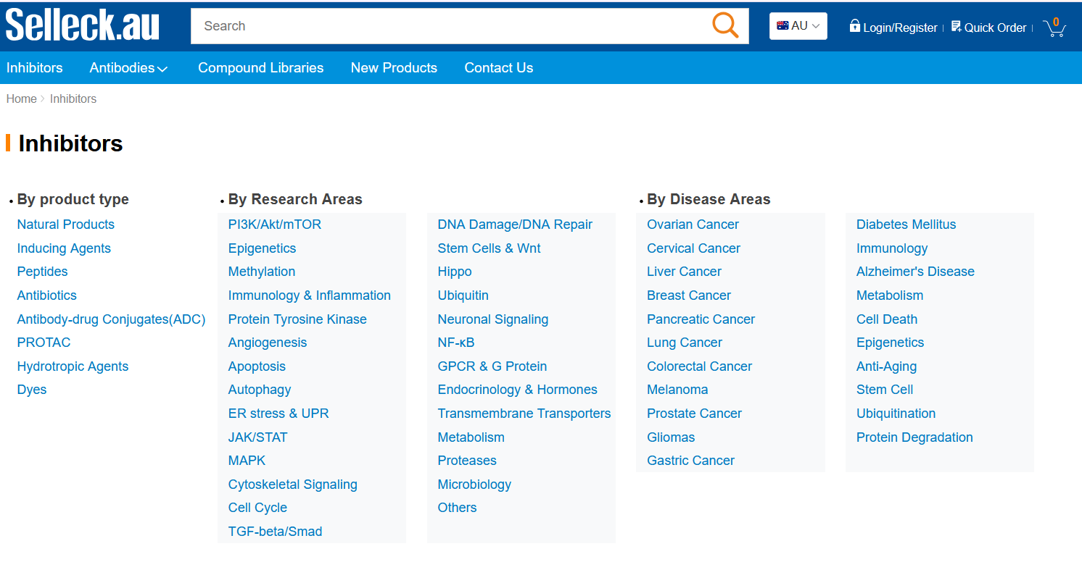
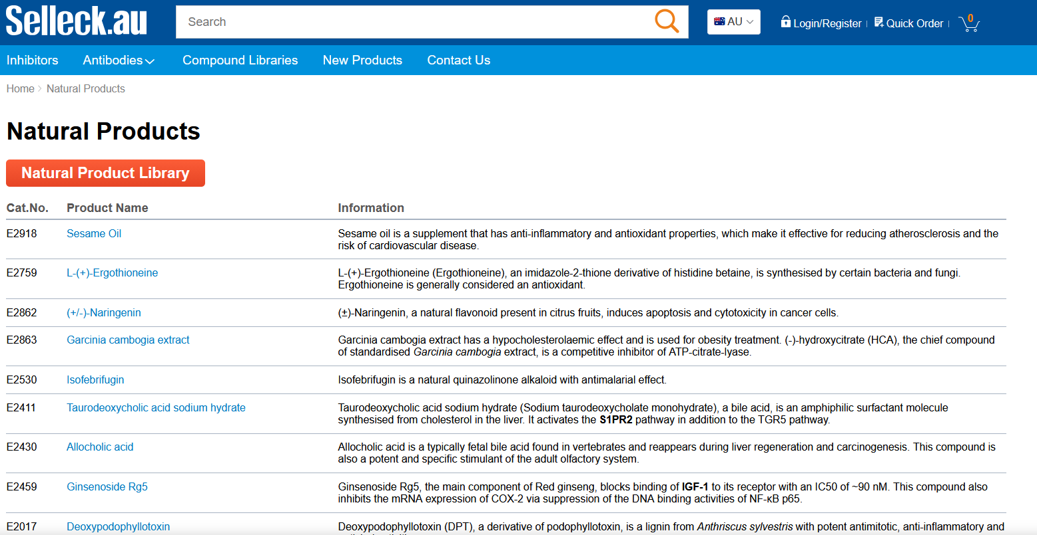
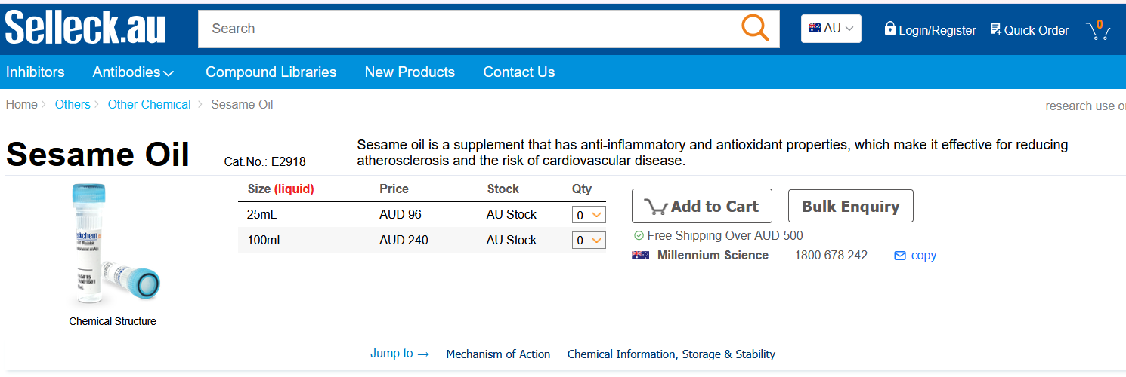
Sumber Data untuk Harga Bahan Kimia (International)
Selleck – Link to website
Sama, cabangnya banyak juga

Slide 9
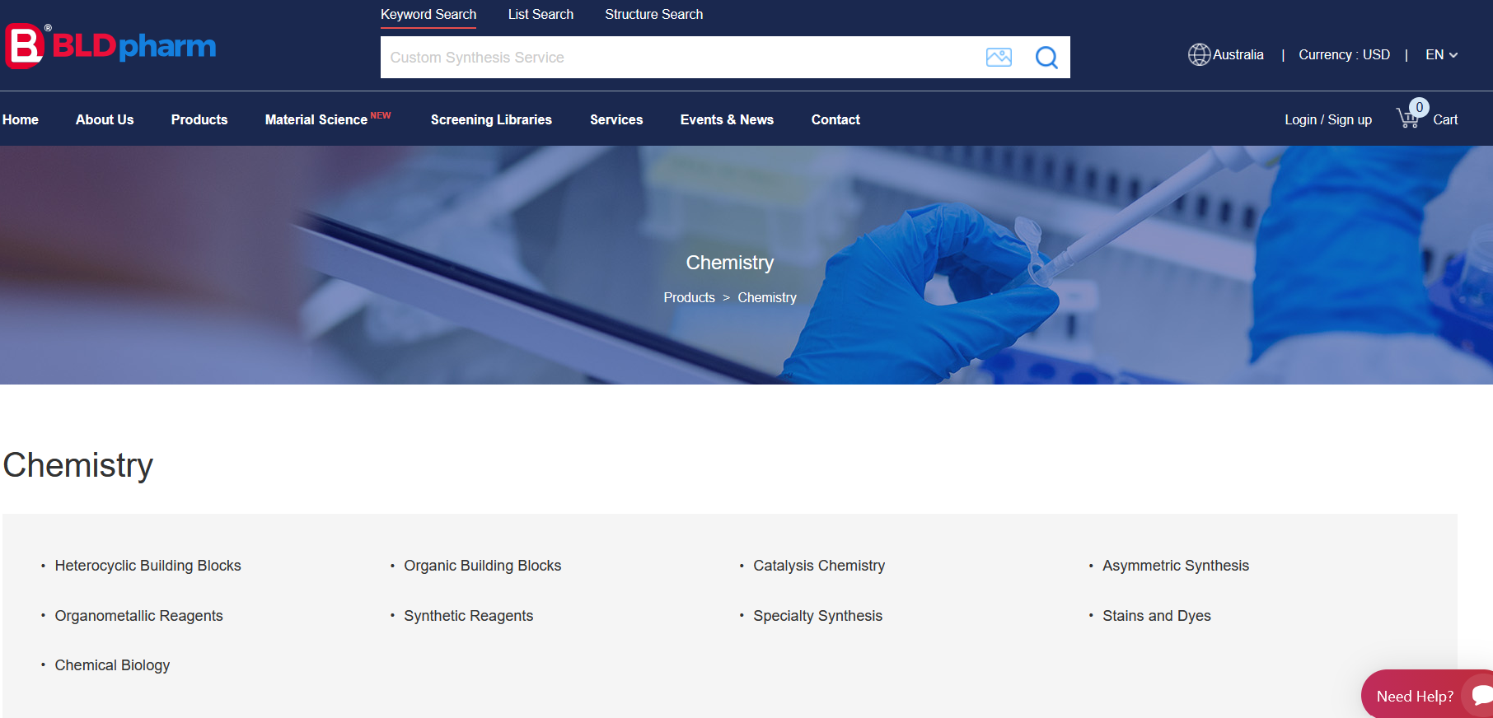
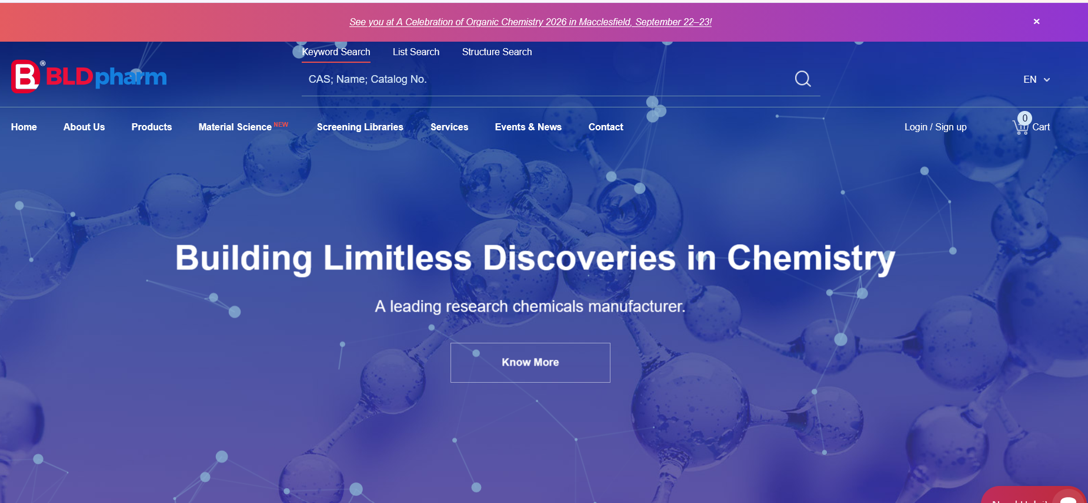
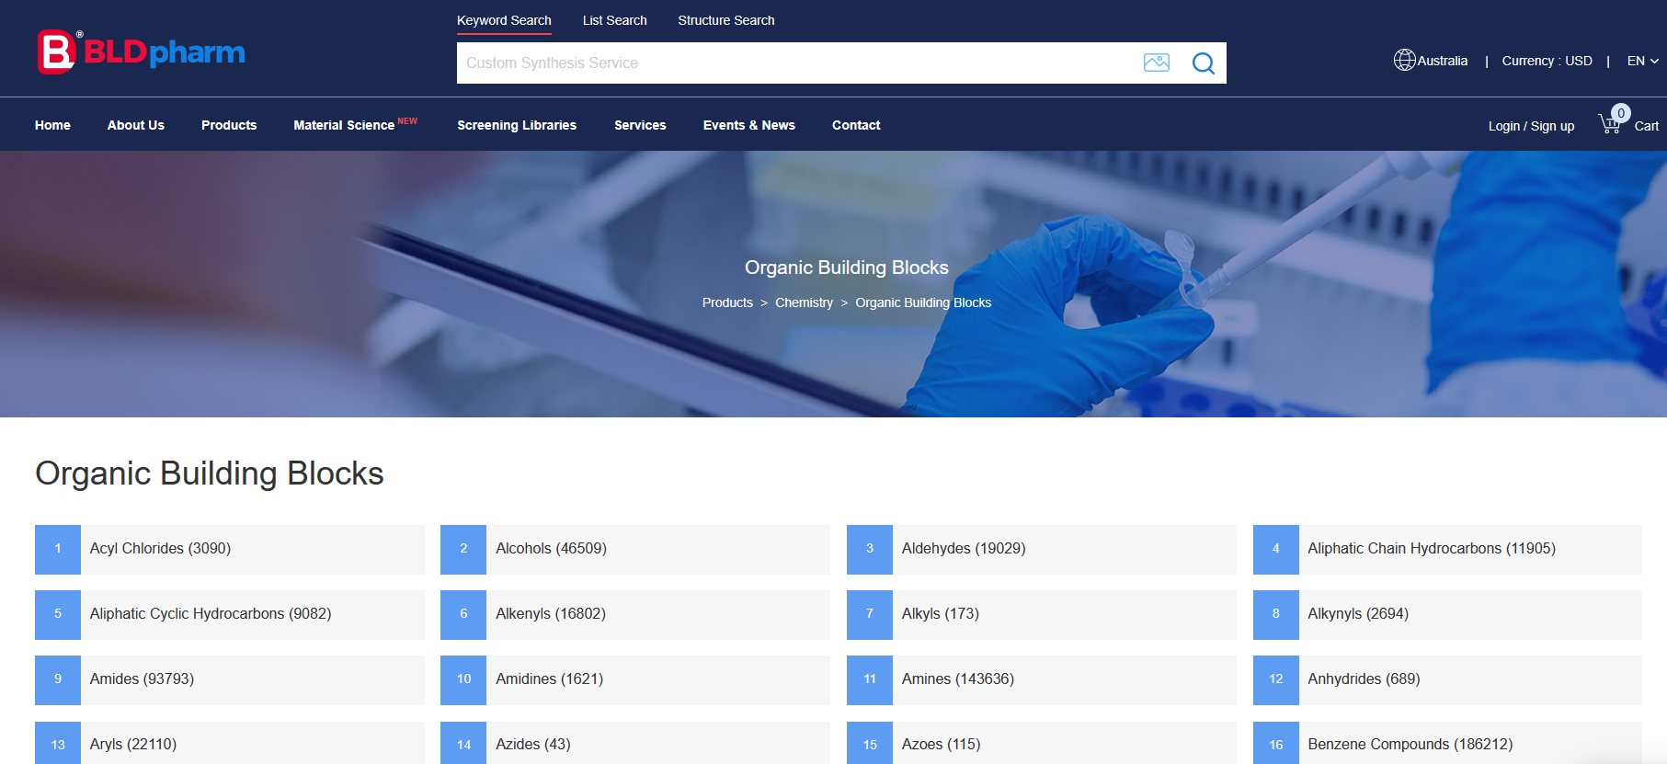
Sumber Data untuk Harga Bahan Kimia (China)
BLDPharm – Link to Website

Slide 10

Sumber Data untuk Harga Bahan Kimia (China)
AccelaChem – Link to Website

Slide 11
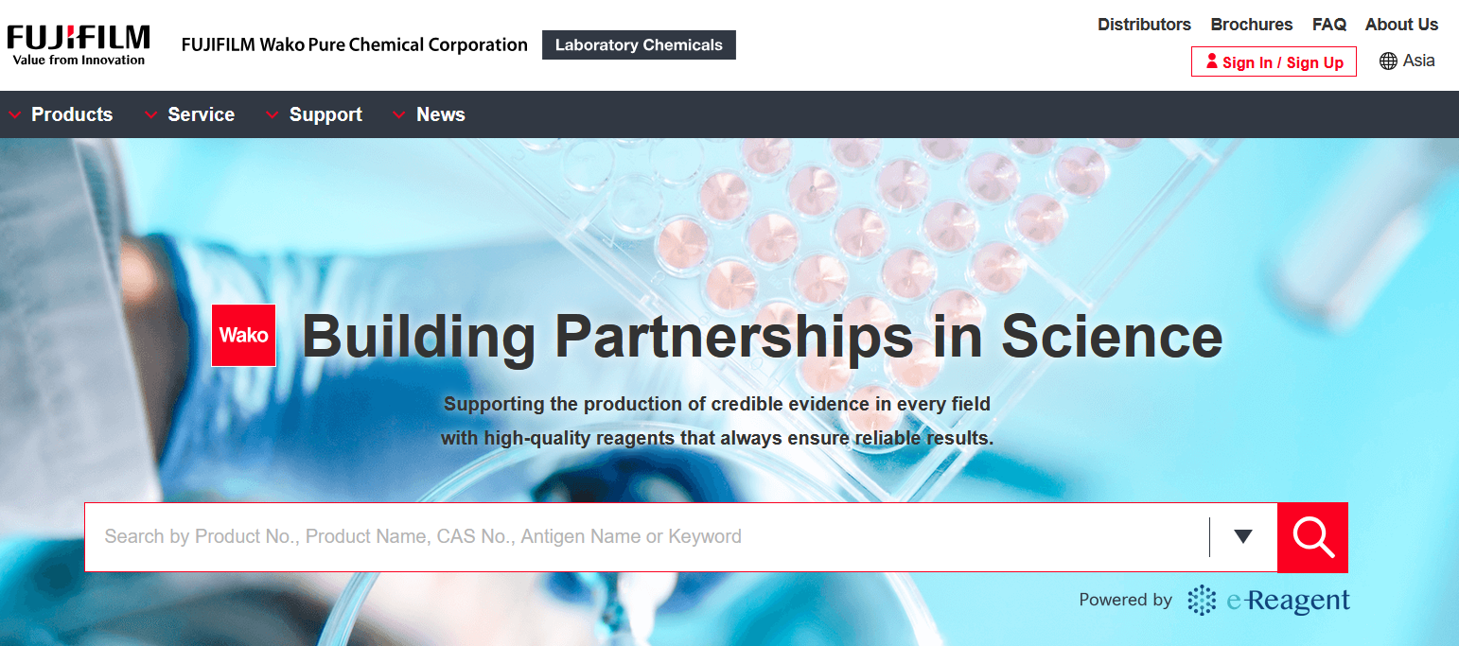
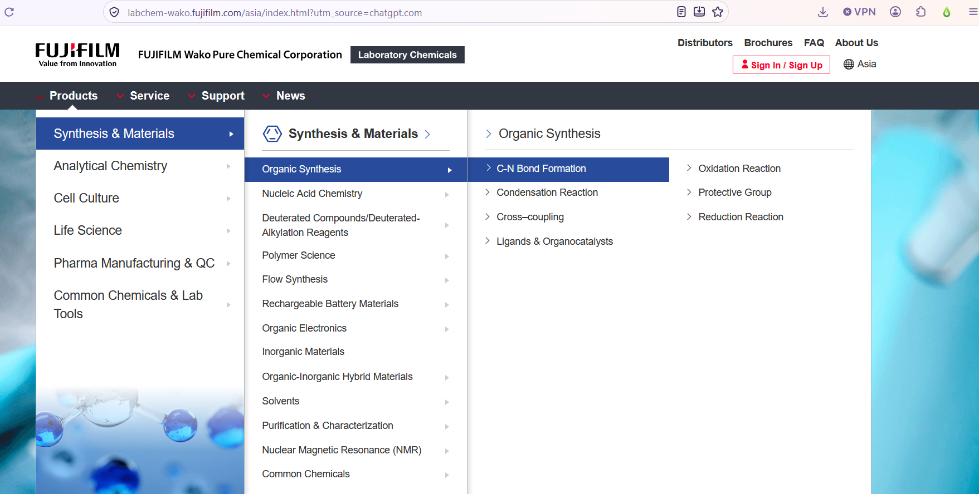
Sumber Data untuk Harga Bahan Kimia (Japan)
Wako Fujifilm – Link to Website
Each of these are compounds

Slide 12
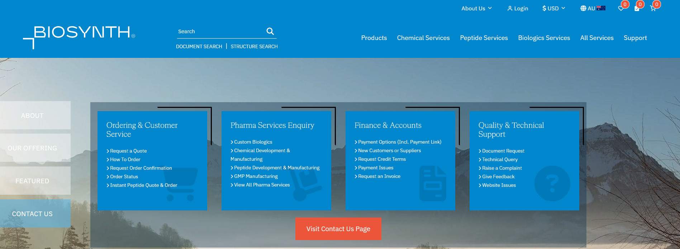
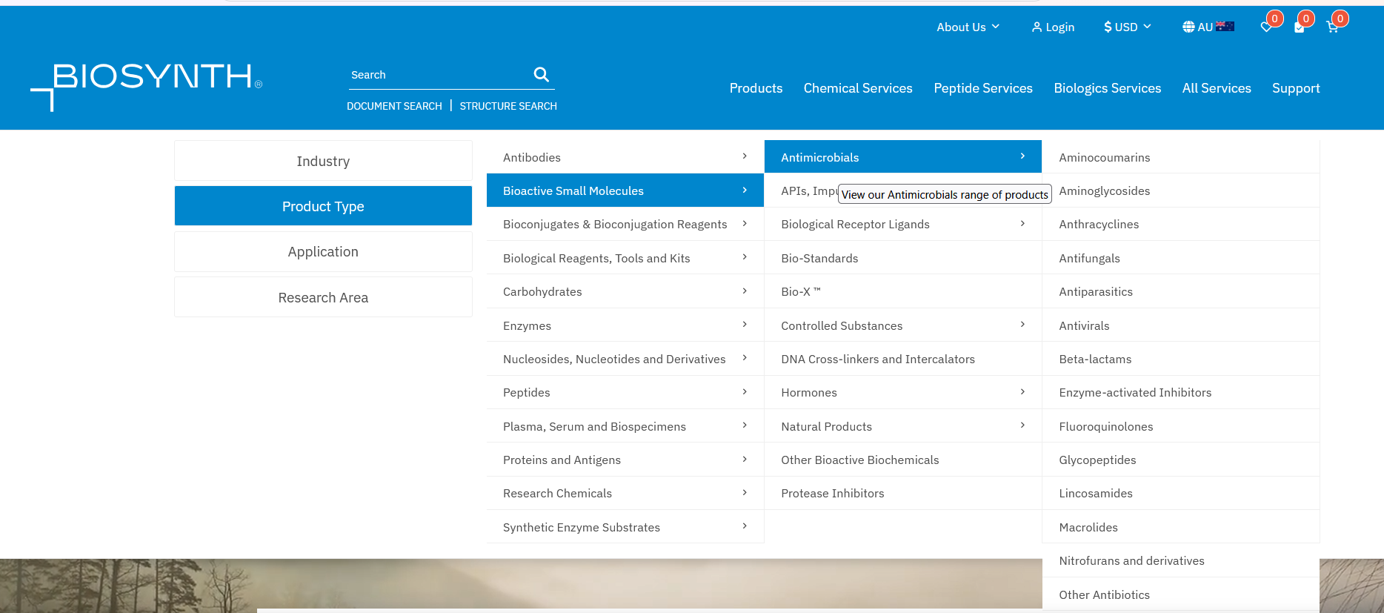
Sumber Data untuk Harga Bahan Kimia (Switzerland)
BioSynth – Link to Website

Slide 13

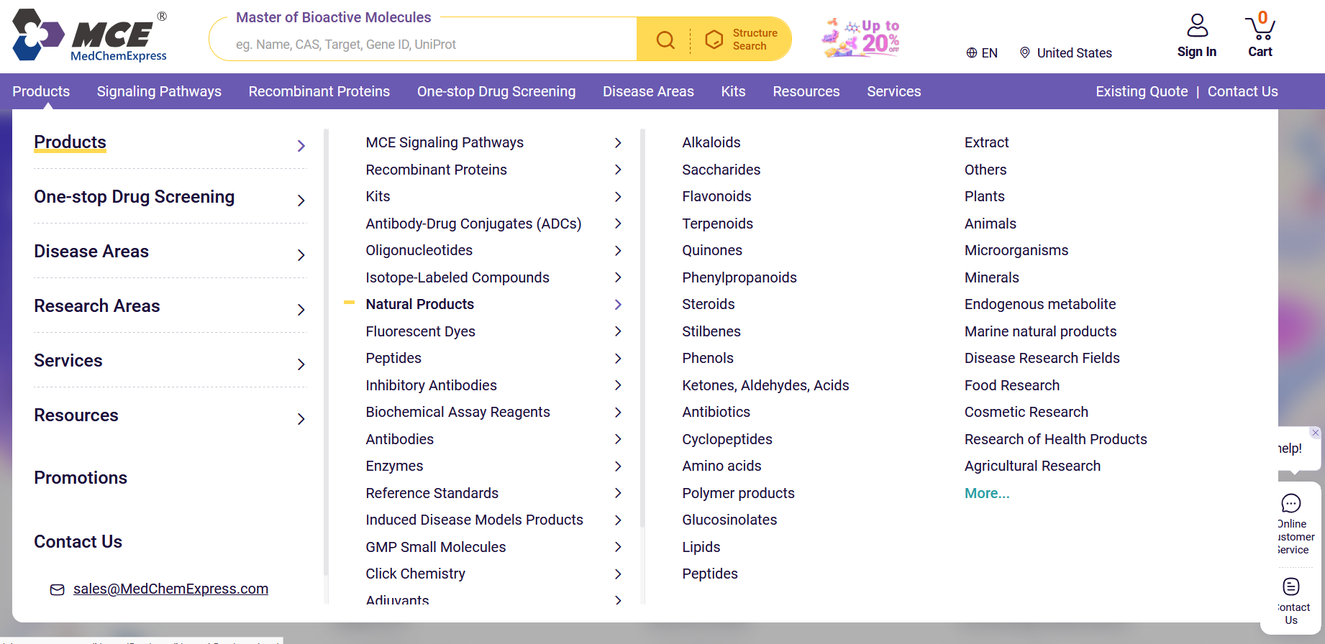
Sumber Data untuk Harga Bahan Kimia (U.S.A.)
MedChemExpress – Link to Website

Slide 14
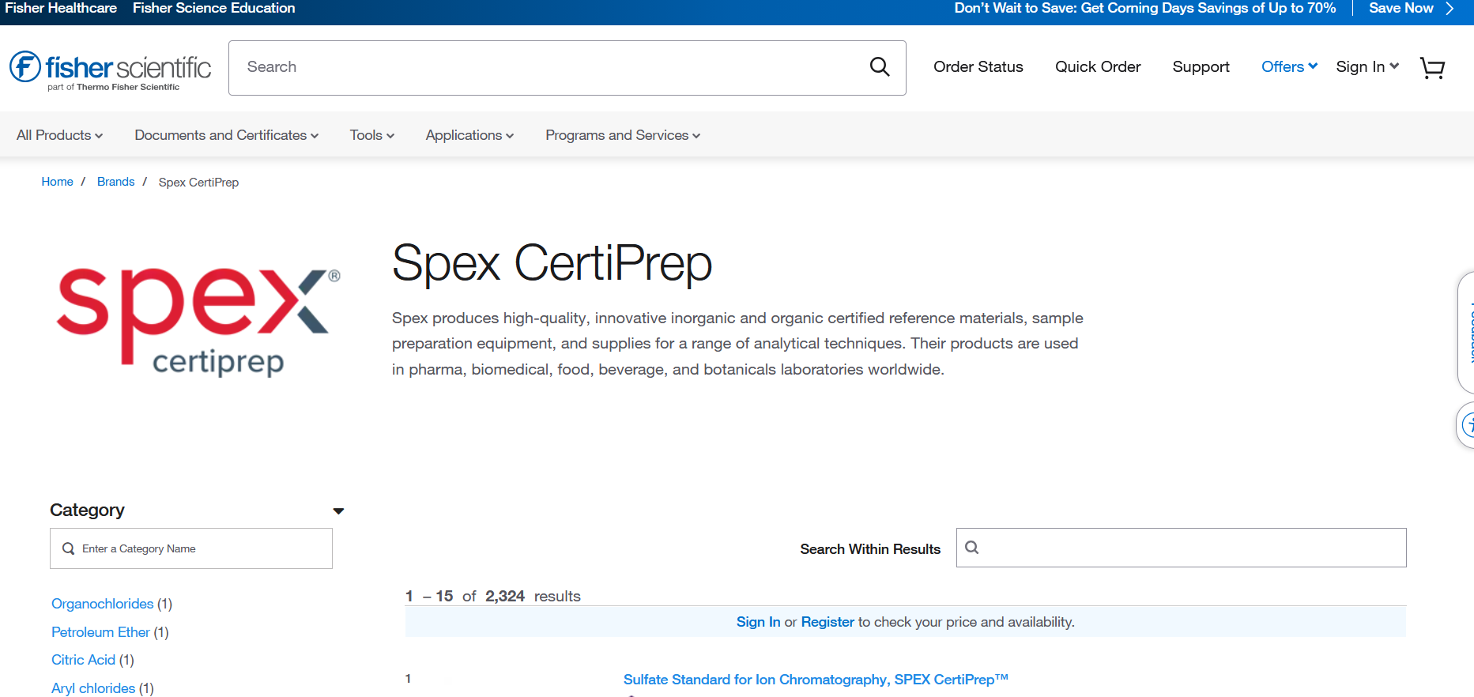
Sumber Data untuk Harga Bahan Kimia (U.S.A.)
SPEX Certiprep – Link to Website

Slide 15
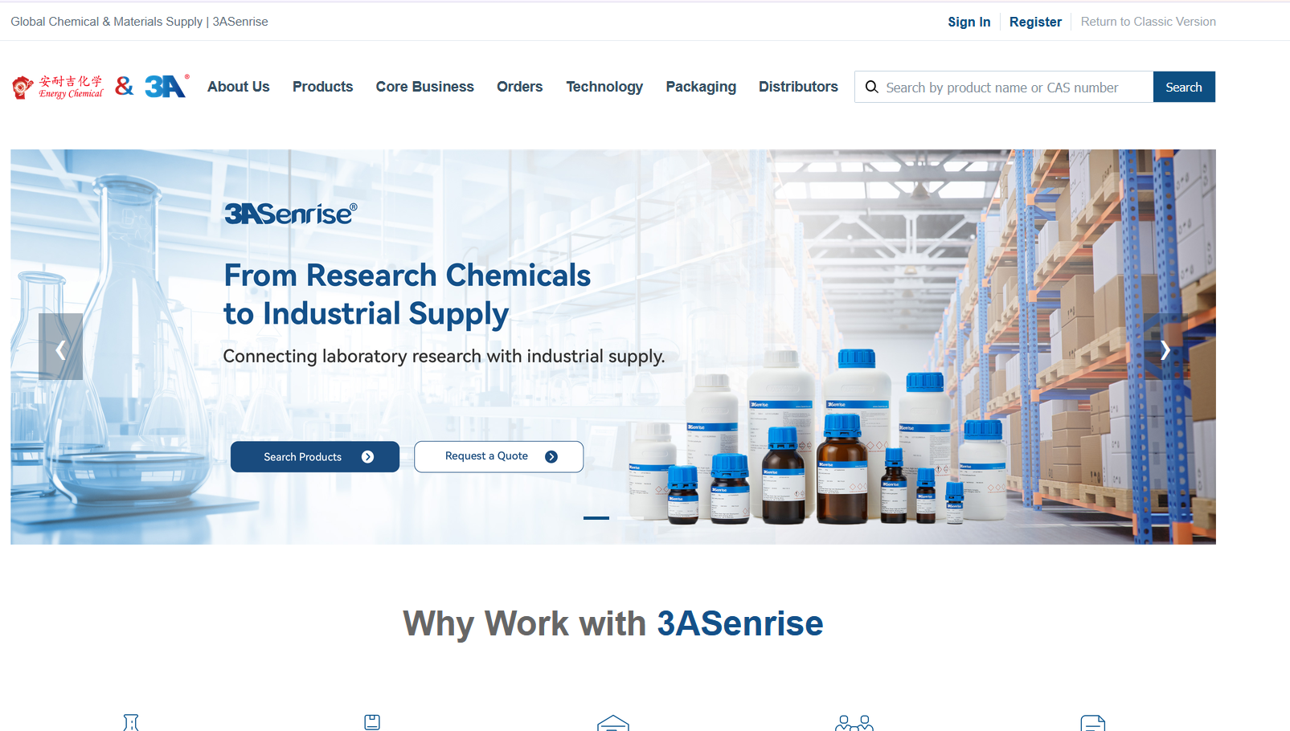
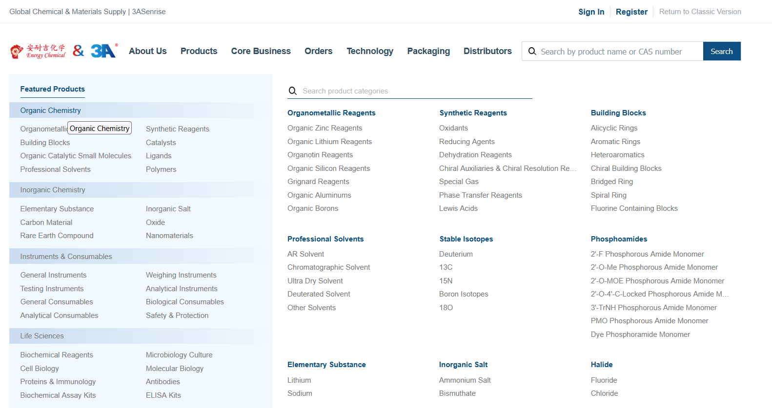
Sumber Data untuk Harga Bahan Kimia (China)
3ASenrise – Link to Website
Fokus di organic chemistrynya aja

Slide 16
Detailed Workflow Description

Slide 17
Proses 1:
Input Data Kimia
Struktur Kimia
User Input
Ubah jadi nama
Nama Kimia
Kirim ke LLM untuk cari senyawa

Slide 18
Proses 2:
Cari Harga Bahan Kimia
Cek ada atau engga & store info ada atau enggaknya
Lanjut ke resep reaksi
Nama Kimia
Input ke LLM
RAG ke vector database
Database berisi daftar harga barang yang sudah discrape dari website

Slide 19
Proses 3:
Cek Harga Bahan Kimia + Resep Reaksi
Ada
Cek harga tiap bahan kimia yang terlibat
Nama Kimia
Cek resepnya ada atau tidak
Kalau sudah ada resepnya, tidak perlu diprediksi lagi
Input ke LLM
RAG ke vector database
Tidak
Lanjut ke model prediksi resep
Ato pake web scrape? Soalnya kek gak ada source central untuk resep kimia

Slide 20
Proses 4:
Model Prediksi Resep Reaksi
Cek harga tiap bahan kimia yang terlibat
Nama Kimia
Konversi ke struktur
Input ke model prediksi resep

Slide 21
Price Summary
Summary
Chemical Name
Topiramate
Output dari harga barang kimia
Availability in the Market
Source | Price | Link
Sigma – Aldrich | 20 AUD / g | …
Thermo Fisher | 20 AUD / g | …
Etc. | … | …
Output dari harga barang kimia + resep reaksi
Established Synthesis Route
Output dari harga barang kimia + resep reaksi
Recipe figure
Material Name | Source | Price | Link
Toluene | Sigma – Aldrich | 2 AUD / g | …
Toluene | Thermo Fisher | 2.3 AUD / g | …
KOH | Etc. | … | …

Slide 22
Alternative Summary
Summary
Chemical Name
Topiramate
Availability in the Market
It seems like the compound is not available in the market yet…
Established Synthesis Route
It seems there is no established synthesis route for this compound
Predicted Synthesis Route
Recipe figure
Material Name | Source | Price | Link
Toluene | Sigma – Aldrich | 2 AUD / g | …
Toluene | Thermo Fisher | 2.3 AUD / g | …
KOH | Etc. | … | …

Slide 23
Kompetitor

Slide 24
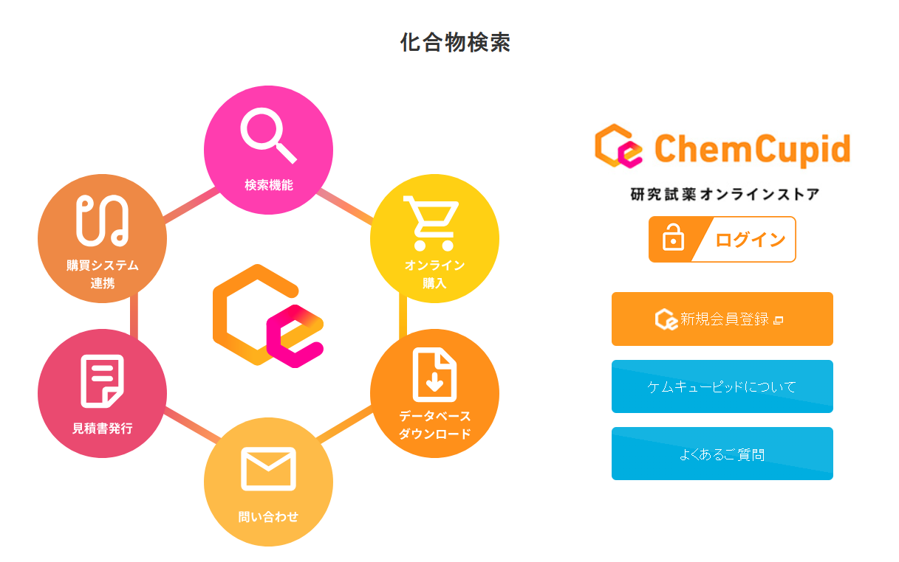
Ternyata ada yang mirip kek kita haha, tapi ini di market Jepang
Namanya ChemCupid

